Slide 1
Osage plains
By Derek, Daegon, Alex

Slide 2
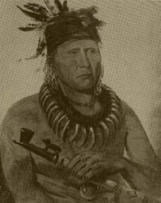
The Osage plains are named after a importan indin tribe that used to live there.

Slide 3
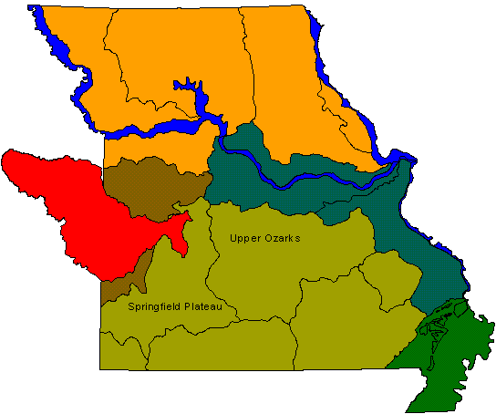
The Osage plains extend into the Great Plains of Kansas and Colorado.

Slide 4
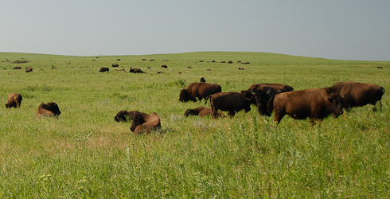
The grass had grown on the plains for thousands of years.

Slide 5
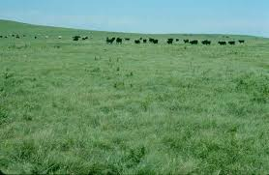
In the summer, when the wind blew the Osage plains looked like waves of the ocean.

Slide 6
Before farmers came to the region and cleared the land many types of grass covered the land.

Slide 7
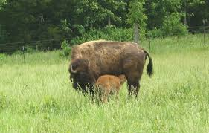
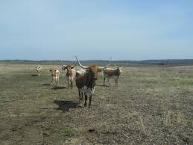
Many farmers still let grass grow on their land to feed their cattle.

Slide 8
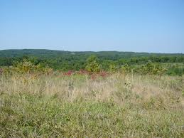
Farmers also grow wheat and hay.

