Slide 1
Mississppi Lowlands
By Hudson and Noe

Slide 2
Boot heel
The lower region of Missouri is called the boot heel” because it looks sort of like a boot.

Slide 3
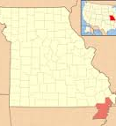
This is where it is located.

Slide 4
Mississippi river
Do you know where the Mississippi river runs?
Well, the Mississippi river runs through Louisiana.

Slide 5
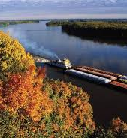
This is the Mississippi River.

Slide 6
EARTH QUAKE!!!!!
Did you know that on the New Madrid Fault which runs through Missouri, in 1811 there was the most powerful earth quake?

Slide 7
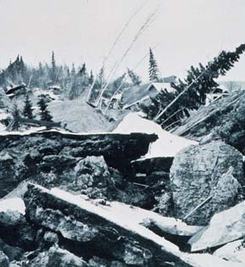
This is the earth quake that hit the New Madrid Fault in 1811.

Slide 8
News about Indians.
There is a park called Trail of Tears State Park. Nine of the Cherokee Indian groups were relocated.

Slide 9
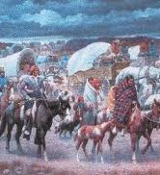
Cherokee Indians being relocated.

