Slide 1
Glacial plains
By Ellie and Jadea

Slide 2
Farming
Glacial Plains has the best land in the state for growing crops
Some farmers raised cattle in the Glacial Plains
Rich farmland makes this an attractive place for growing corn and soy beans

Slide 3
Farming picture!

Slide 4
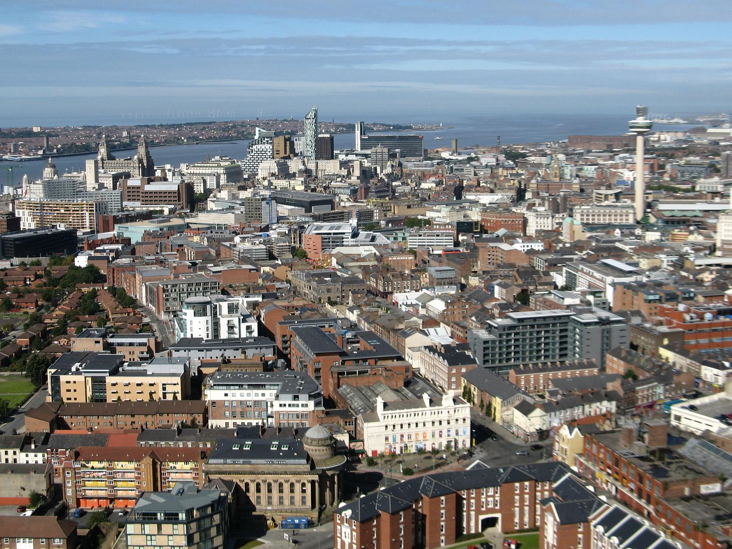
Towns and cities
There are many towns and cities in the Glacial Plains including: Columbia, St. Joseph, Kirksville, Hannibal, Kansas City, Jefferson City, Independence, and St. Louis.

Slide 5
Famous Missourians
Famous Missourians from the Glacial Plains includeing: Auguste Chouteau, Mary Easton Sibley, James Beckwourth, Father Jean de Smet, John Berry Meachum, Susan Elizabeth Blow, Tom Bass, Mark Twain,and Yogi Barra.

Slide 6
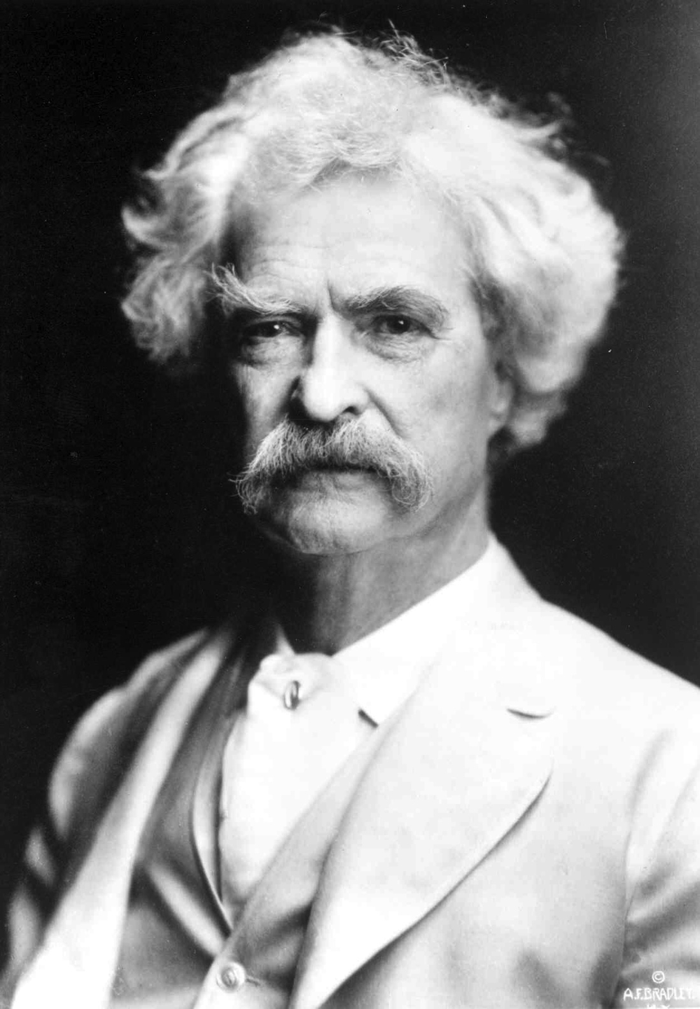
Mark Twain
Mark twain grew up in Hannibal.
Many people from all over the world come and visit the place where Mark Twain grew up.

Slide 7
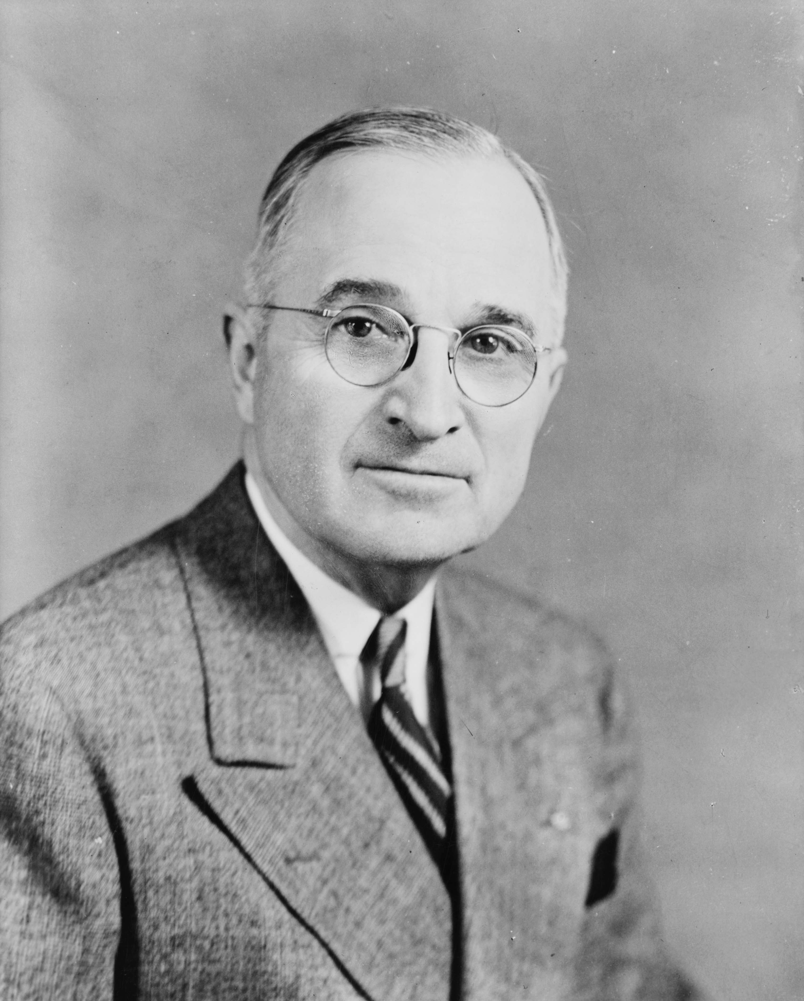
Harry S. Truman
Harry Truman was the first Missourian to become a president of the USA.
Truman lived in Independence.
Harry was the 33rd president of the United States.

Slide 8
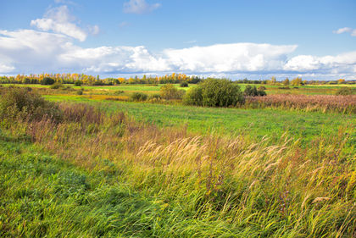
Glacial Plains’ land
The region has lots of rolling hills and flat plains.
Created by large glaciers of ice.

