Slide 1
Ozark Highlands
By Alex I, Amaan, Ja’Shon

Slide 2
Ozark Highlands
The Ozark Highlands is hilly and has deep valleys and cliffs.

Slide 3
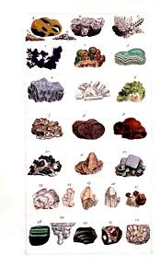
It has Zink, Iron, Limestone, Sand, Clay, and Gravel.

Slide 4
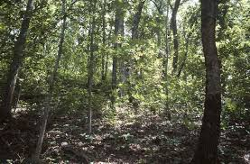
The Ozark Highlands has a lot of forests. There aren’t crops because it’s rocky. It has many wild animals. It is beautiful. Waters are fed from spring water.

Slide 5
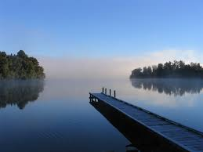
The highest point in the state is in the Ozarks. The green and lovely Ozark region is one of Missouri’s most important geographic landmarks. It has cave , lakes, and more.

