Slide 1
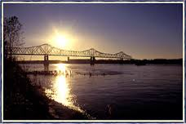
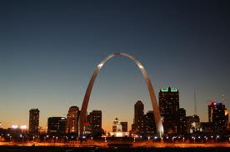
Mississippi Lowlands
The Arch
Over sunlight
By
Brooklynn, Brianna, and E’Ladia

Slide 2
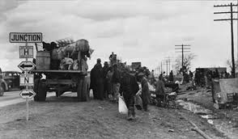
Before Time
The real name is the boot heel.
100 years ago swamps coved the Mississippi Lowlands.
Farmers cleaned the land and made buildings.
The people made cotton.
The region almost sunk in 1811, because of a earthquake.
Here’s a old day picture.
Notes:
Here’s a old day picture.

Slide 3
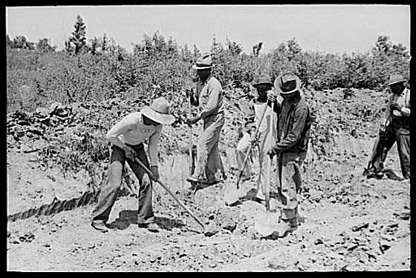
Farming
It’s known for it’s soil.
There beans, rice and cotton is transported all the world.
They get the most rain.
The lowlands has rich black soil.
The old farming times.

Slide 4
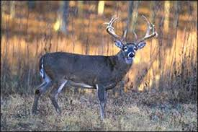
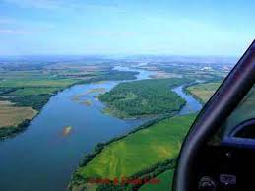
Nature
Nature has been here for a long time.

Slide 5
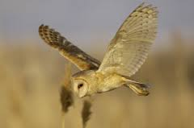
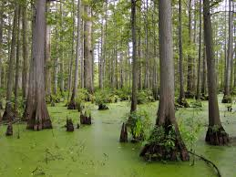
Wild
It is a swamp that covers land.

